Slide 1

Building Confidence

Slide 2
Confidence
Poised, balanced, breathing easily, purposeful movement, can deal with anything, can laugh at yourself, knowing it will be okay eventually.

Slide 3
Self-awareness: what are you good at?

Slide 4
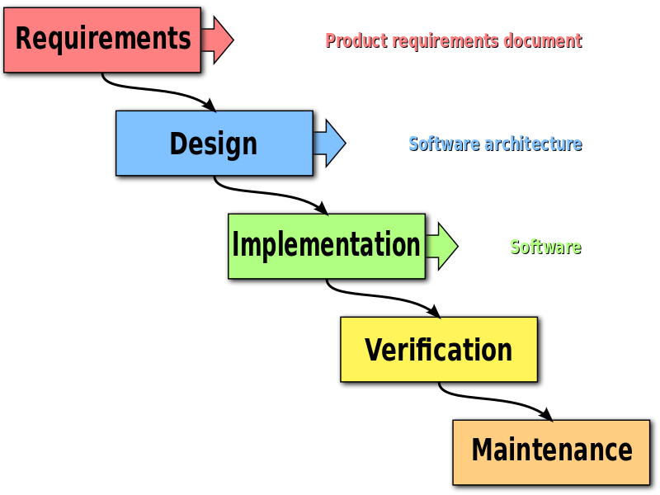
What can hurt confidence

Slide 5
What can hurt confidence?
Taking on too much work.
Belittling leaders.

Slide 6
Questions to ask yourself and others
What am I good at?
When have you seen me at my best?
What should I do more of?
What should I do less of?
Where do you think I can stretch?

Slide 7
What is the next thing you need big confidence for?
While there is value in the items on the right, there is more value in the items on the left
Visualize:
Where? Who? What skills?
Which thoughts/feelings?
Why is confidence important here?
If you couldn’t fail, what would you do?

Slide 8
What is the next thing you need big confidence for?
Visualize:
Where? Who? What skills?
Which thoughts/feelings?
Why is confidence important here?
If you couldn’t fail, what would you do?

Slide 9

Notes:
Activity: What is one thing you are had trouble with your curriculum project? Type it into the chat! Observe how you talked about that thing. Now, reframe it confidently. Contemplate why that matters.

Slide 10
Act even though you’re scared
Notes:
Take on that new tech issue or ticket with the audacity and gall to be better for doing so. For impressing yourself.

Slide 11
Replace weak filler words with stronger filler words
“Like,” “um,” “and uh”
“You see,” “Now,” “However”
Notes:
Even a stated “hmmm” and articulating a moment to think

Slide 12
When the troll’s on your back, ask, “What am I choosing to do about it?

Slide 13
1. Don’t pick apart every mistake or foolish thing you’ve done. Laugh at them and realize life isn’t always a “repair job” of everything you did wrong

Slide 14
2. You haven’t (yet) become what you thought you would. That’s OK. Accept it and make a difference.

Slide 15
3. Surround yourself with one inspirational story every day

Slide 16
4. Keep a Mental Journal

Slide 17
5. Plan to Celebrate. Celebrate Your Wins

Slide 18
Bernice Moore’s Theory
Improve your competencies
Put them into practice
See results
Grow more confident
Repeat

Slide 19
More Resources
https://www.thriveglobal.com/stories/26490-these-5-things-will-give-you-the-confidence-to-accomplish-anything
https://www.ted.com/talks/amy_cuddy_your_body_language_shapes_who_you_are
https://www.theatlantic.com/magazine/archive/2014/05/the-confidence-gap/359815/
Detect under-confident language: https://chrome.google.com/webstore/detail/rosie/hdlcmlhedjiljdeaijfbpdigffccgcbc

